Slide 1
Gender Crossing Tales a case for Myth & Metaphor
Stella Fremi, PhD. University of Brighton
‘MYTH(S) IN SOCIAL SCIENCES & HUMANITIES’ CONFERENCE
UNIVERSITY OF YORK, May 2015

Slide 2
it is about…
a doctoral study that aims to redefine gender transition- beyond clinical & politicized ‘label identities’
ancient & modern creation myths/cultural metaphors, weaving threads of norms & mores
to unveil the mythic elements inscribed in the narratives & masked as representations of reality

Slide 3
“tales from the clinic”
criminally insane, masquerade
‘transvestism treated surgically’
transsexualism: medical stories of euphoria, “twice born”
transvestism: stigmatized
transgenderism; no medical interventions
Transgender Studies; generic, progressive
saturated space of othering
politicized academic cultures
hierarchies
regardless of diagnosis: injustice & lack of recognition

Slide 4
Sociological research; ‘story telling’
Ekins & King (2006). 4 trajectories of stories/bodily social practices; oscillating, migrating, negating, transcending
categorical identity??
motivation??
lack of recognition??

Slide 5
This study
Discourses: classical narratives...
a journey from dysphoria to euphoria
The ‘good life fantasy’
3 independent focus groups: 13 ‘male to female’ individuals, various cross-gender expressions
discourses, shared & unique accounts, interactional processes, emotional processes, subject positions

Slide 6
An instance of epiphany
description of the climate of trans-gender politics as characterized by “a wild profusion of gendered subject positions, spawned by the rupture of ‘woman’ and ‘man’, like an archipelago of identities rising from the sea” (Stryker, 1998).
the birth myth of goddess Aphrodite.

Slide 7
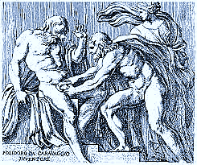
dismantling
conventional gender
categories..
emergence of trans-gender
selves…

Slide 8
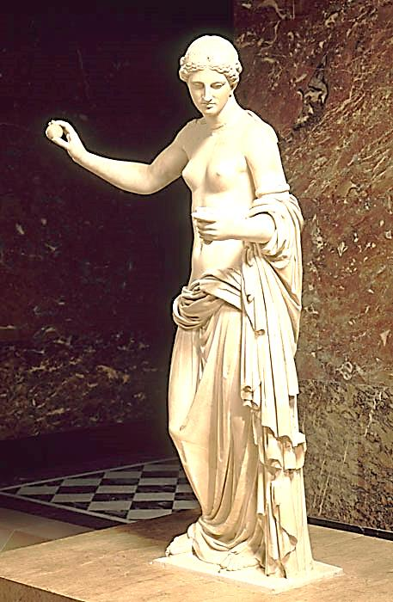
decisive awareness
..birth of
something
beautiful

Slide 9
The birth of Aphrodite
a scene of conventional fantasy; un-doing as a prelude to progress
Cruel Optimism (Berlant, 2011): an injurious attachment that obstructs reality; the pursuit of the desired goal is defective & destructive
becoming Aphrodite is unattainable – but hoping to become her is reassuring & sustaining……even in the face of evidence to the contrary

Slide 10
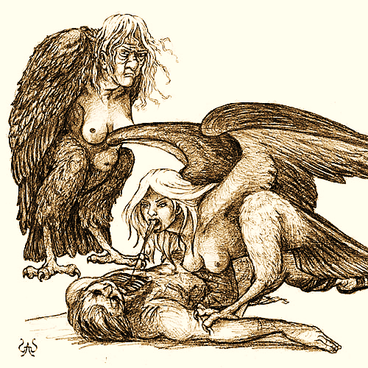
Aphrodite’s sisters…
The Furies (Erinyes)
“the embodiment
of self-cursing
contained in
an oath”

Slide 11
Gender Crossing Tales
deconstructing the birth myth of Aphrodite & constructing a new myth that allows for the entry of the Other
binary ruptures, boundaries & bonds
Freak Discourse (Shildrick, 2002) ; embodied & discursive shifts/alternating states of being; human to freak
monstrosity as a condition of becoming

Slide 12
A Monster’s Tale
‘corpus differentiis’
vulnerable: no escape from harm/ unliveable life
Frankenstein’s Monster: assemblage of (cadaver’s) parts, “in-between”
efforts to belong// attempts to ‘invade’
‘haunting’

Slide 13
Pandora’s Box
panopticism in action, self-surveillance
a ‘forged Aphrodite’; a ‘hopeful’ monster that transforms into a new species
compromised endurance/adaptive change
de-monstrating monstrosity

Slide 14
Gender Crossing Tale(s)
Monster & Pandora: same being, ‘done’ & ‘un-done’; shared embodied feelings, desire & fear
“Pandora is the cut flesh which has been moulded into a beautiful goddess, while Frankenstein’s Monster has been left to sink into the blood; de-humanized, he becomes a Fury – ‘the angry one’ “ (p. 142)
‘home’: defence against the fear that the dissolution of the image of the new-born female self // ‘Aphrodite Rising’ will defeat capacity to have hope

Slide 15
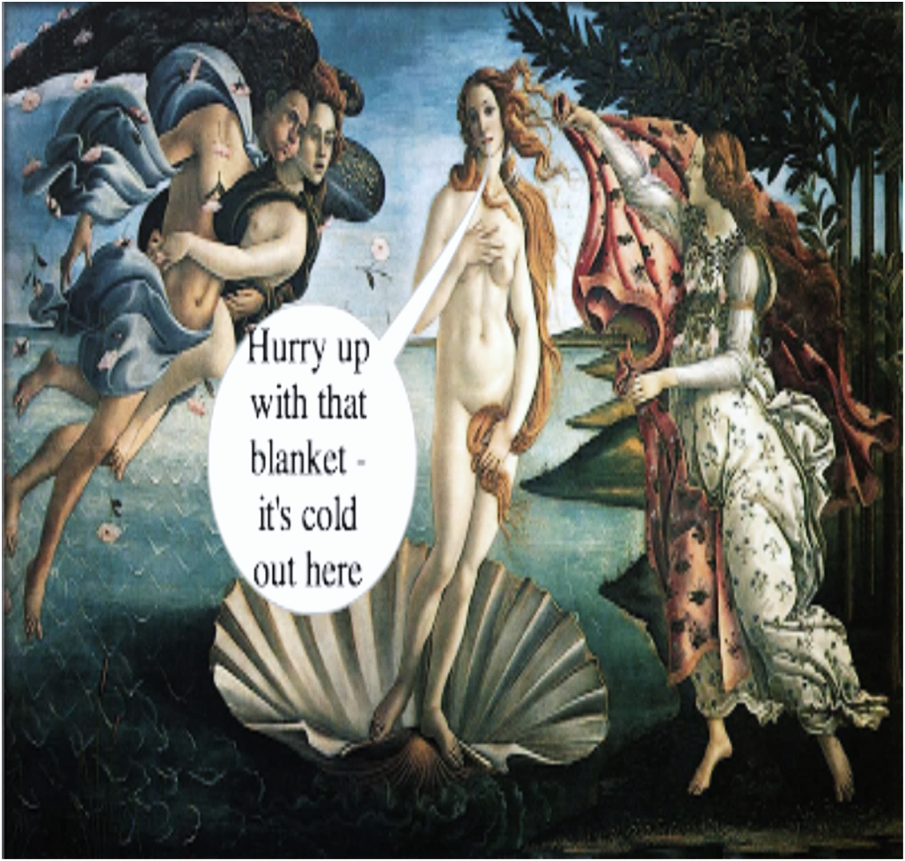
Nostalgic scene;
impossibility of
mythical return

Slide 16
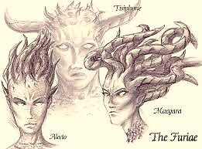
the actual position
Monstrosity=turmoil: no entrance to female ‘home’& human habitus.

Slide 17
The ‘Trans Tale’
a mere lifetime old; lacks cohesion
alternating states of ‘beauties’ & ‘beasts’
managing anxiety: the Monstrous Other taking over the ‘normally’ gendered Self
preventing rise of monsters & allowing non-normative gendered people to thrive as embodied subjects
allowing for the entry of the Other

Slide 18
